Slide 1

Computer Programming for Engineers
Week 12 Lecture 2
Nov. 17, 2022
Lecturer: Dr. Mohammad Mahdi Javidan
College of Engineering, Sungkyunkwan University
Fall Semester 2022

Slide 2
Graph Search
A graph
A
A
Edge
B
C
F
E
B
C
F
E
Node
D
D
Graphs can be directed or undirected
Edges can have weights
https://www.python.org/doc/essays/graphs/
College of Engineering, Sungkyunkwan University

Slide 3

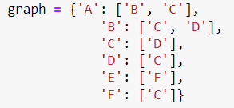
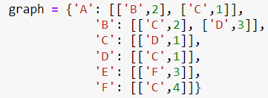
Graph Search
A
B
C
F
E
D
A
2
1
2
4
3
B
C
F
E
3
1
1
D
College of Engineering, Sungkyunkwan University

Slide 4
Graph Search
Find a path from A to D
A
B
C
F
E
D
Backtracking algorithms
College of Engineering, Sungkyunkwan University

Slide 5
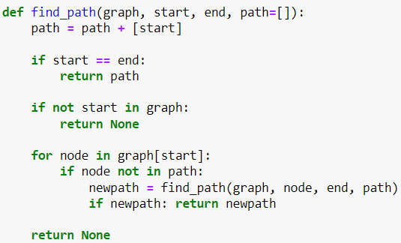


Graph Search
A
Default value
Destination has reached
B
C
F
E
Arcs
Avoiding cycles
D
College of Engineering, Sungkyunkwan University

Slide 6
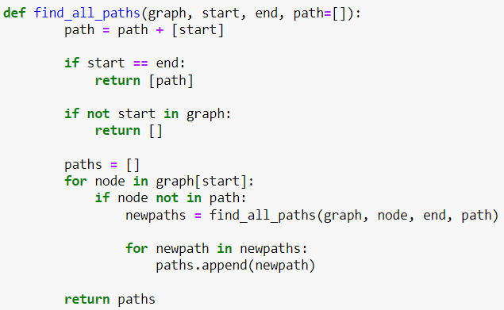
Graph Search
A
B
C
F
E
Avoiding cycles
D
By adding some more lines, it is possible to find the shortest path
College of Engineering, Sungkyunkwan University

Slide 7
Game as Trees
In most cases, we can use graphs
State 1
Move
State 2
The problem changes to graph search
However, the path can change
Each node represents a game state
State is a game position, score, etc.
http://web.mit.edu/sp.268/www/gamesearch.pdf
College of Engineering, Sungkyunkwan University

Slide 8
Game as Trees
Branching factor b: the number of outgoing edges from a single node
Start state
Player 1
Move
A
Move
D
Move
B
Move
C
ply: A level of the game tree. A move makes the game tree move to the next ply.
Player 2
Player 1
L
W
L
W
W
L
Depth d: How many plys we need to go down the game tree, or how many moves the game takes to complete.
W
W
L
W
College of Engineering, Sungkyunkwan University

Slide 9
Minmax Algorithm
Start state
At each state:
Player 1 wants maximize the score
Player 2 wants minimize the score
Therefore we need to use backtracking recursively
Player 1
A
C
B
Player 2
A
B
C
A
B
C
A
B
C
Player 1
C
A
B
A
B
C
A
A
B
C
A
B
C
2
7
15
2
7
9
4
4
10
11
2
15
7
College of Engineering, Sungkyunkwan University

Slide 10
Minmax Algorithm
Start state
Player 1
A
C
B
Player 2
A
B
C
A
B
C
A
B
C
Player 1
7
15
2
7
9
4
10
11
15
C
A
B
A
B
C
A
A
B
C
A
B
C
2
7
15
2
7
9
4
4
10
11
2
15
7
College of Engineering, Sungkyunkwan University

Slide 11
Minmax Algorithm
Start state
Player 1
A
C
B
Player 2
2
4
10
A
B
C
A
B
C
A
B
C
Player 1
7
15
2
7
9
4
10
11
15
C
A
B
A
B
C
A
A
B
C
A
B
C
2
7
15
2
7
9
4
4
10
11
2
15
7
College of Engineering, Sungkyunkwan University

Slide 12
Minmax Algorithm
Start state
Player 1
10
A
C
B
Player 2
2
4
10
A
B
C
A
B
C
A
B
C
Player 1
7
15
2
7
9
4
10
11
15
C
A
B
A
B
C
A
A
B
C
A
B
C
2
7
15
2
7
9
4
4
10
11
2
15
7
Player 1 is doing the best given Player 2 is doing the best
If one doesn’t the best one can, then the other play will have a better condition
College of Engineering, Sungkyunkwan University

Slide 13
Tic-Tac-Toe
Player 1
Win
A
B
C
Player 2
D
E
F
G
Player 1
H
I
J
Lose
Tie
Tie
Tie
College of Engineering, Sungkyunkwan University

Slide 14
Implementation
0
Player 1
0
1
Player 2
0
1
2
3
Player 1
0
1
2
3
4
5
6
7
Player 1 is doing the best given Player 2 is doing the best
If one doesn’t the best one can, then the other play will have a better condition
College of Engineering, Sungkyunkwan University

Slide 15
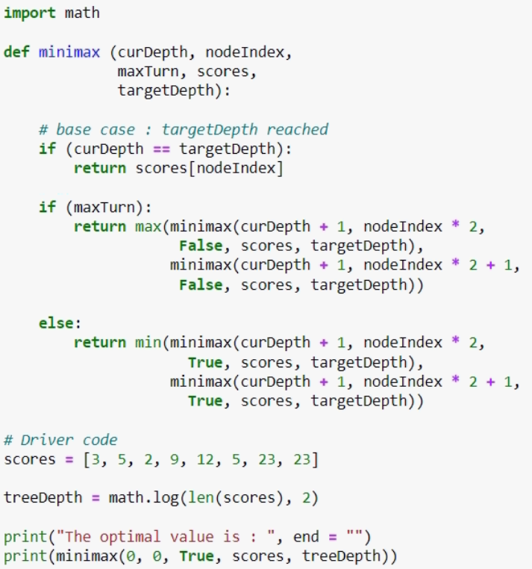

Implementation
0
0
1
0
1
2
3
0
1
2
3
4
5
6
7
https://www.geeksforgeeks.org/minimax-algorithm-in-game-theory-set-1-introduction/
College of Engineering, Sungkyunkwan University

Slide 16
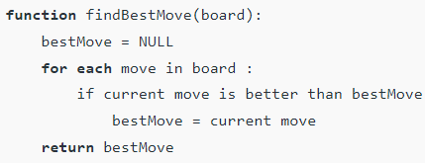
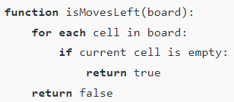
Tic-Tac-Toe
Pseudocode for implementation in Python
The function findBestMove evaluates all available moves using minmax
The function isMoveLeft checks whether a move is available or not
https://www.geeksforgeeks.org/minimax-algorithm-in-game-theory-set-3-tic-tac-toe-ai-finding-optimal-move/
College of Engineering, Sungkyunkwan University

Slide 17
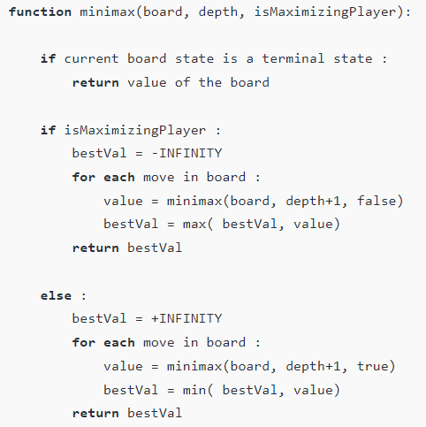
Tic-Tac-Toe
Pseudocode for implementation in Python
The function minmax returns a value
College of Engineering, Sungkyunkwan University

